Slide 1
ʔixp̓aʔomas, λiλos Pət̓e

Slide 2
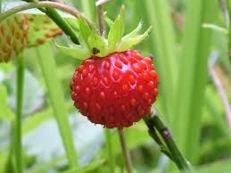
L̓əǧu- Wild strawberres - Harvest in June.
L̓əǧu

Slide 3
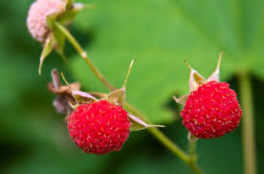
cəǧəɫ - Thimble Berries – tart berry, used for jams. The shoots are picked early May and are rich in vitamins
cəǧəɫ

Slide 4
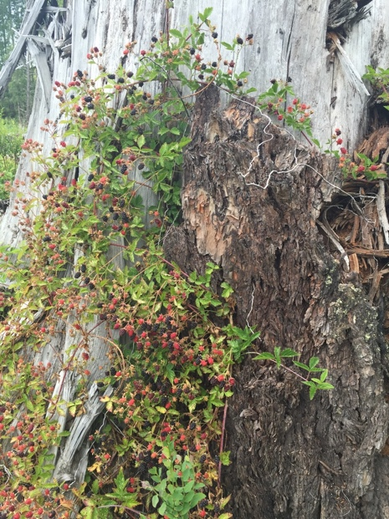
Dusdək̓ʷa. – Trailing wild blackberries – The berries are high in nutrients.. Duxʷm̓as - is the plant. You may dry the leaves and mix with rose hips. Its great for stomach ailments. Harvest berries in June-July
Dusdək̓ʷa

Slide 5
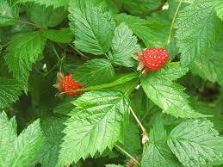
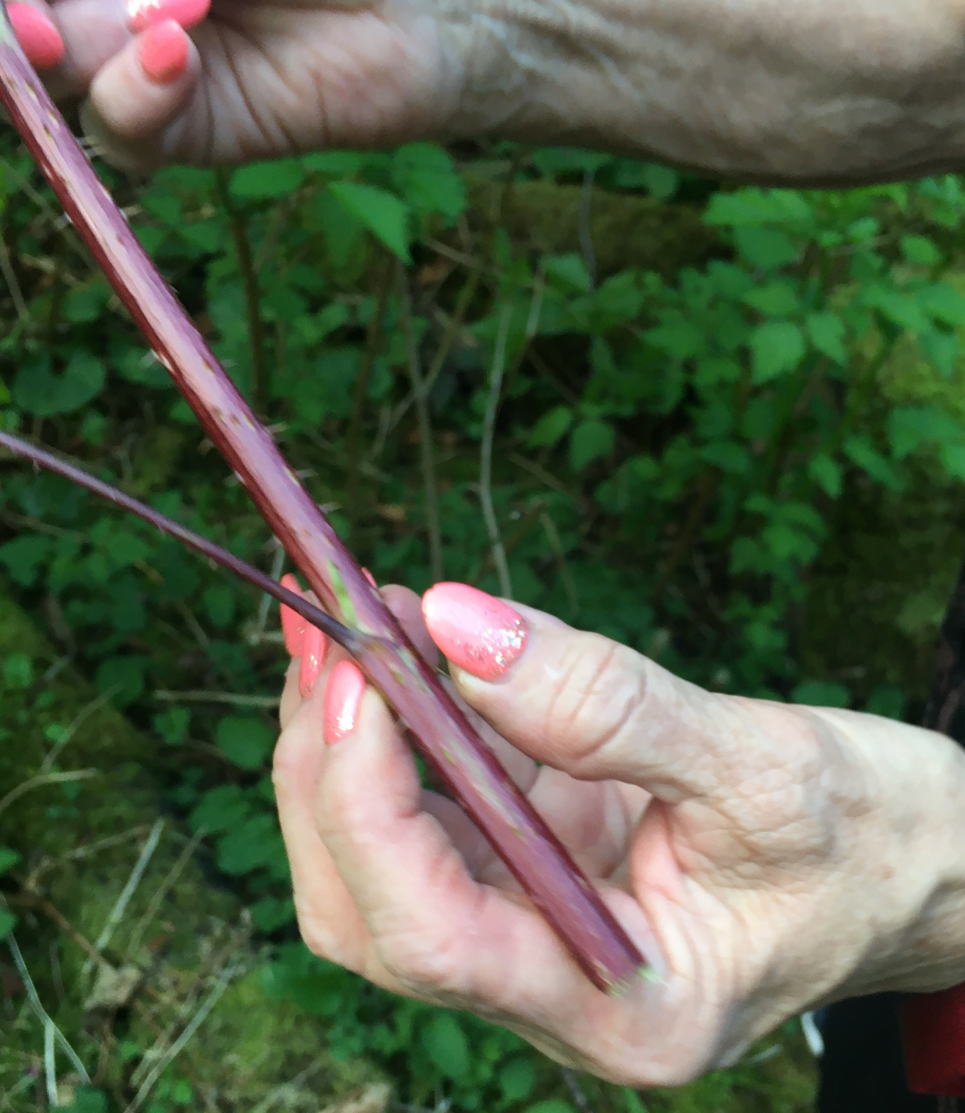
q̓əmdᶻəkʷ – Salmon berries. – The shoots are picked in early May and are rich in vitamins. As children we dipped in sugar. The berries were mixed with oolican grease. Harvest berries in June.
q̓ʷəłəm
q̓əmdᶻəkʷ

Slide 6
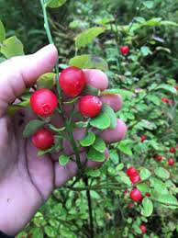
Ǧʷadəm - Huckleberries - They grow on stumps after forest is logged. Berries are picked in July. First nations pounded berries and let them sun dry and were rolled up for the winter. Our first fruit roll ups.
Ǧʷadəm

Slide 7
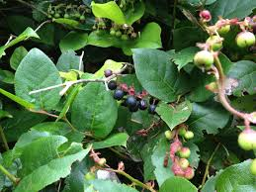
Nasukʷ- (L) – salal berries - Harvest in June – July.
Nək̓ʷəɫ - (K)
nasukʷ - L nək̓ʷəɫ - K

Slide 8
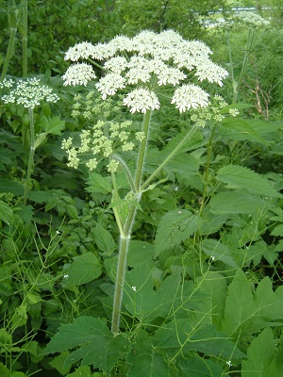
k̓umaq̓a – cow parsnip is the hollow stem, ǧisdəm is the edible stalk, harvest the stalks in May. The seed is called q̓əx̌əmin from the cow parsnip plant. It is used in teas for colds, pneumonia, and sucked on for sore throats. In years past it was used on stoves to ward of bad spirits. Harvest the seeds in late June when the flowers are finished.
k̓umaq̓a

Slide 9
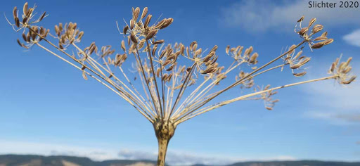
q̓əx̌əmin - barestem parsley…harvest this in July. It is used in teas for colds and suck on the seeds for sore throat. Our singers use the q̓əx̌əmin in the bighouse as they sing for many hours and it soothes the throat.
q̓əx̌əmin

Slide 10
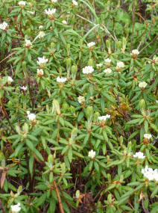
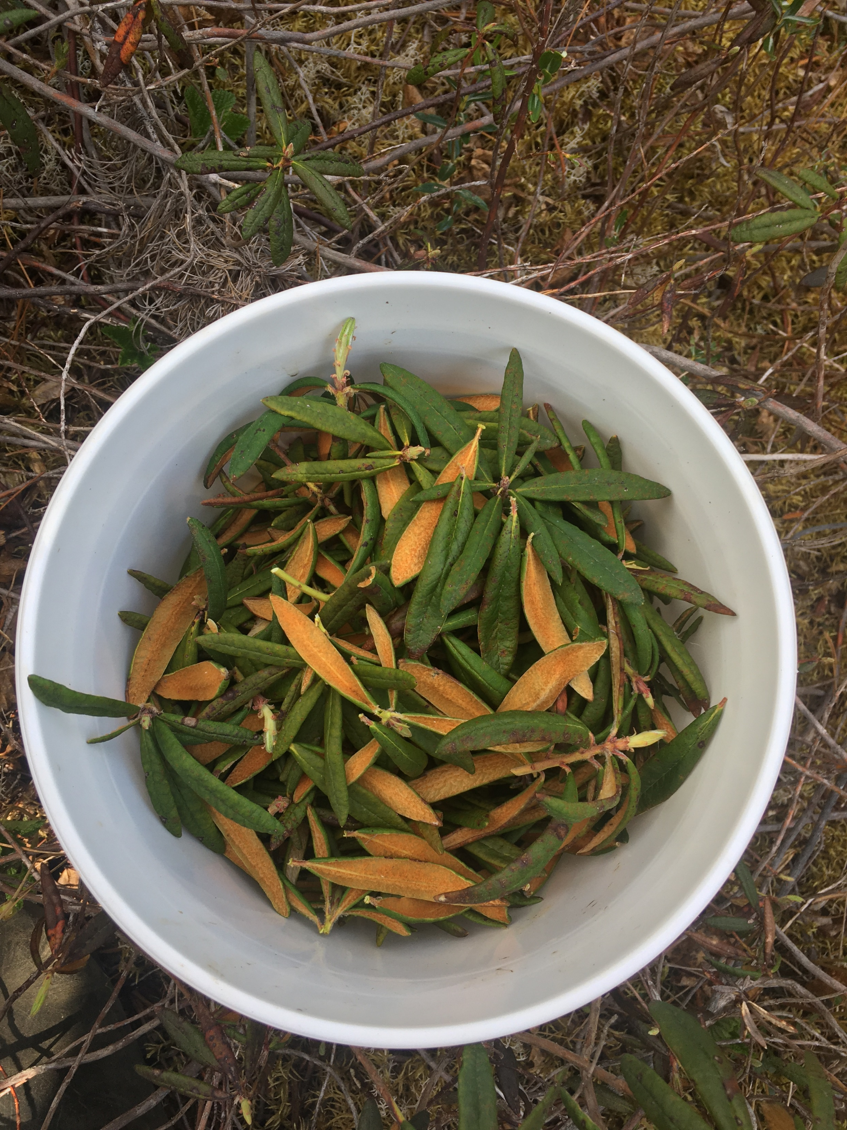
puyas – Labrador tea – Drink small amount to start. Used as a relaxant, for its laxative effect and to help treat arthritis. Harvest only when the leaves are orange inside. If silvery do not pick. Harvest most of the year.
puyas

Slide 11
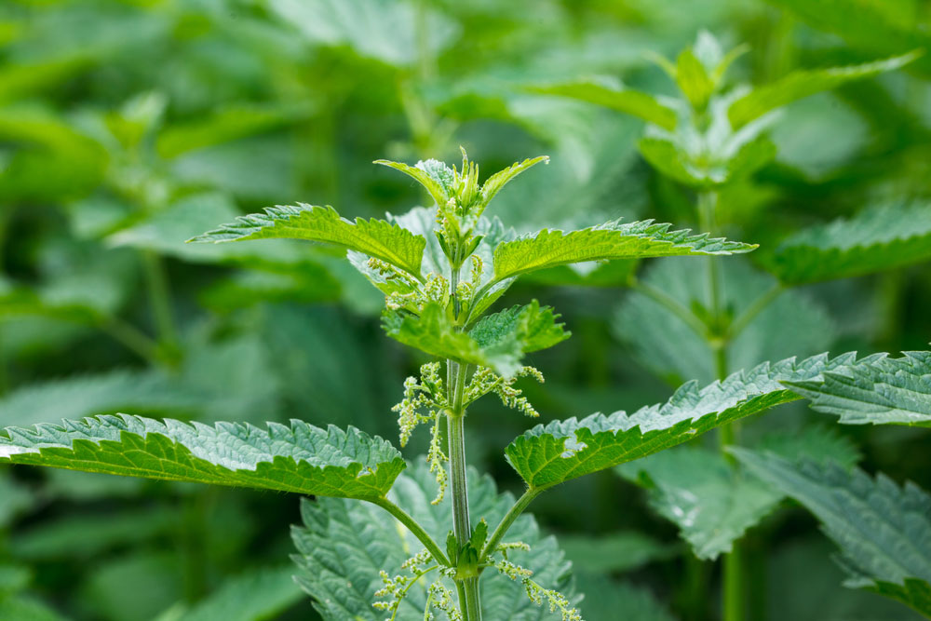
Dᶻəndᶻənxƛəm – Stinging Nettle - Excellent source of vitamins. The leaves are dried and steeped into tea. It is used for arthritis and also good for asthma and as a blood purifier. It is also good for bronchitis, mixed with the q̓əx̌əmin. Harvest the new shoots as they have stronger medicinal value. Harvest from April to June.
Dᶻəndᶻənxƛəm

Slide 12
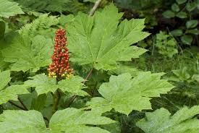
ƛaxʷsuli (L) -ʔixʷmi (K) – The inner bark, roots are consumed as a tea. Tea from the inner bark is commonly used for arthritis and diabetes. When made into salve it is used for arthritis, aches and pains plus it is good for eczema. Harvest in June and July
ƛaxʷsuli (L) -ʔixʷmi (K)

Slide 13
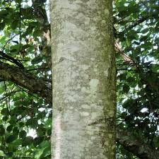
ƛ̓axʷməs – Alder Bark
Bark made into salve to alleviate sores like eczema. Bark was also used as a dye mixed with salmon eggs. Wood was also used for masks and spoons. Harvest from spring to fall
ƛ̓axʷməs

Slide 14
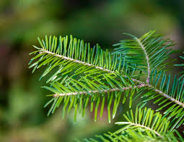
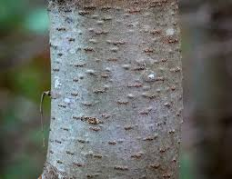
m̓ut̓as – Balsam Bark - m̓əmt̓əni..pitch from the tree…Bark is used for tea. Warriors drank the tea for strength. The tea is high in vitamins. Relieves stomach ailments, and as an inner healer. The branches were used to keep flies and mosquitoes away. Harvest the young bark from June to August.
m̓ut̓as

Slide 15
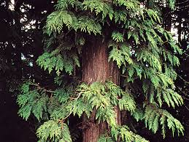
Wəlkʷ - Wilkᵂ - Red Cedar- was used for bighouses, paddles, canoes, storage boxes, the bark was weaved for headpieces, hats, and baskets. Do you not use for soaps and lip balms, you may get cedar poisoning. Harvest bark from May to August.
Wəlkʷ - Wilkᵂ

Slide 16
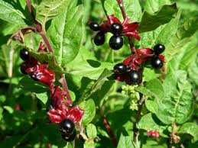
ƛ̓əq̓əx̌uliʔməs – Twinberry - Dry the leaves and mix with natural tobacco, used as a soak to ease dry skin conditions, soak tired feet as well as sprains and gout.
Do not ingest the berries. Harvest from the young trees. Harvest April till June.
ƛ̓əq̓əx̌uliʔməs

Slide 17
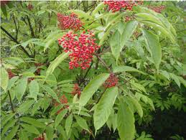
c̓ixm̓əs – Red elderberry tree - Berries (c̓ixina) were made into jam.
c̓ixm̓əs

Slide 18
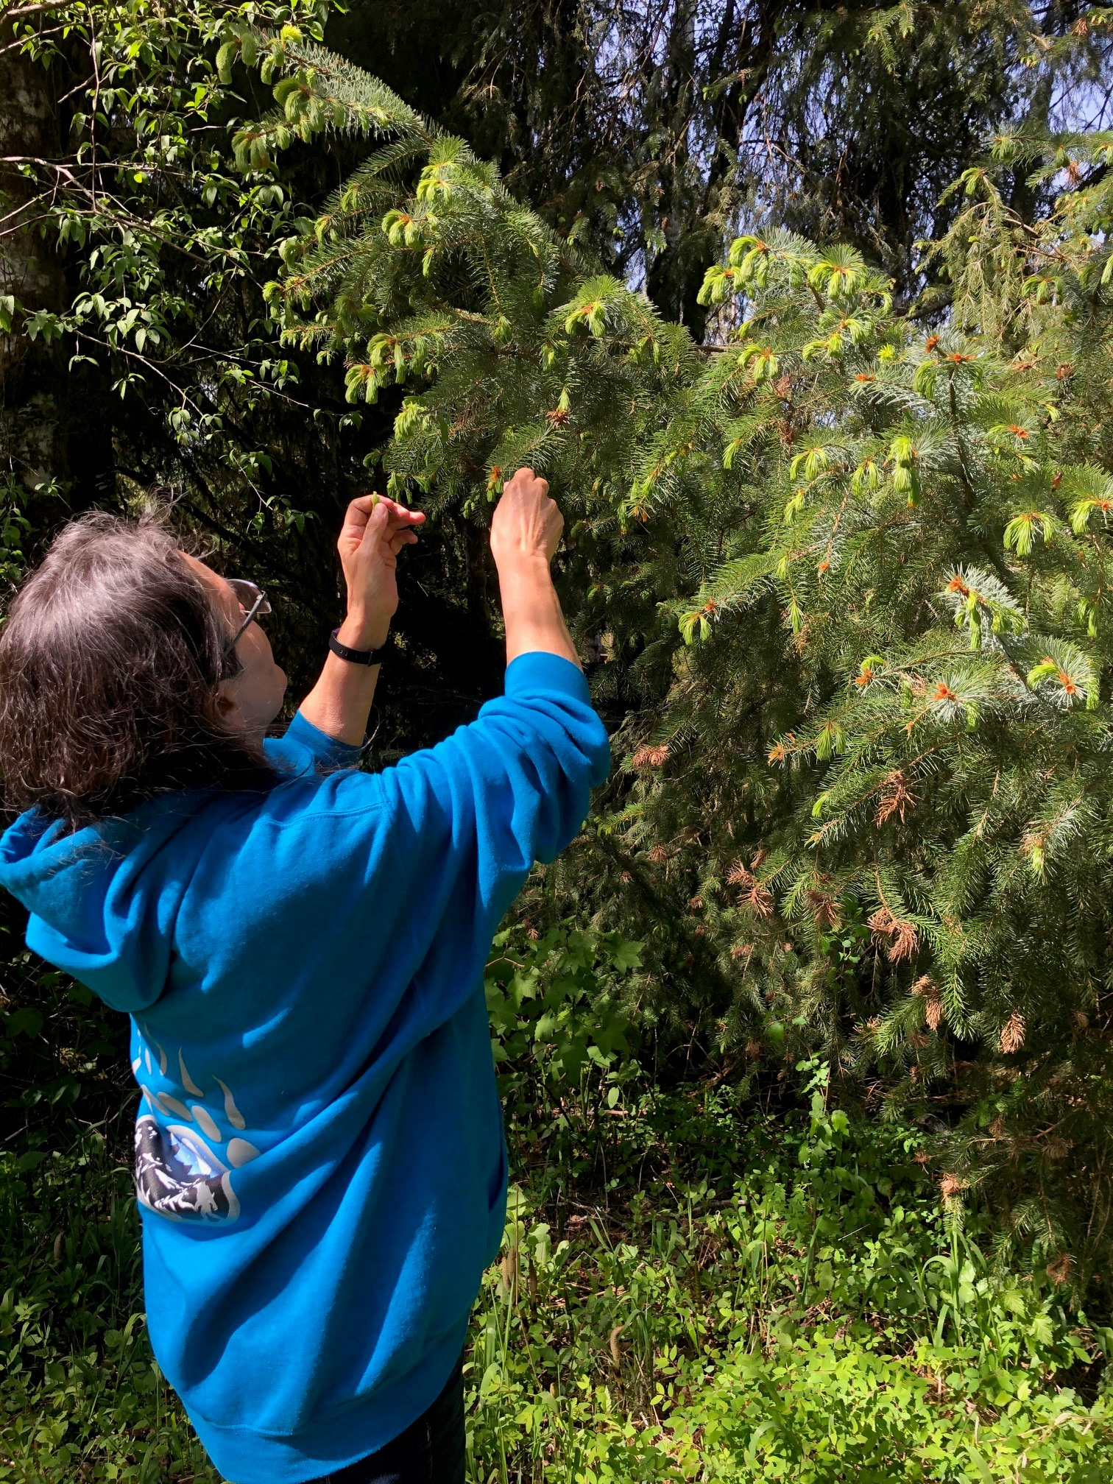
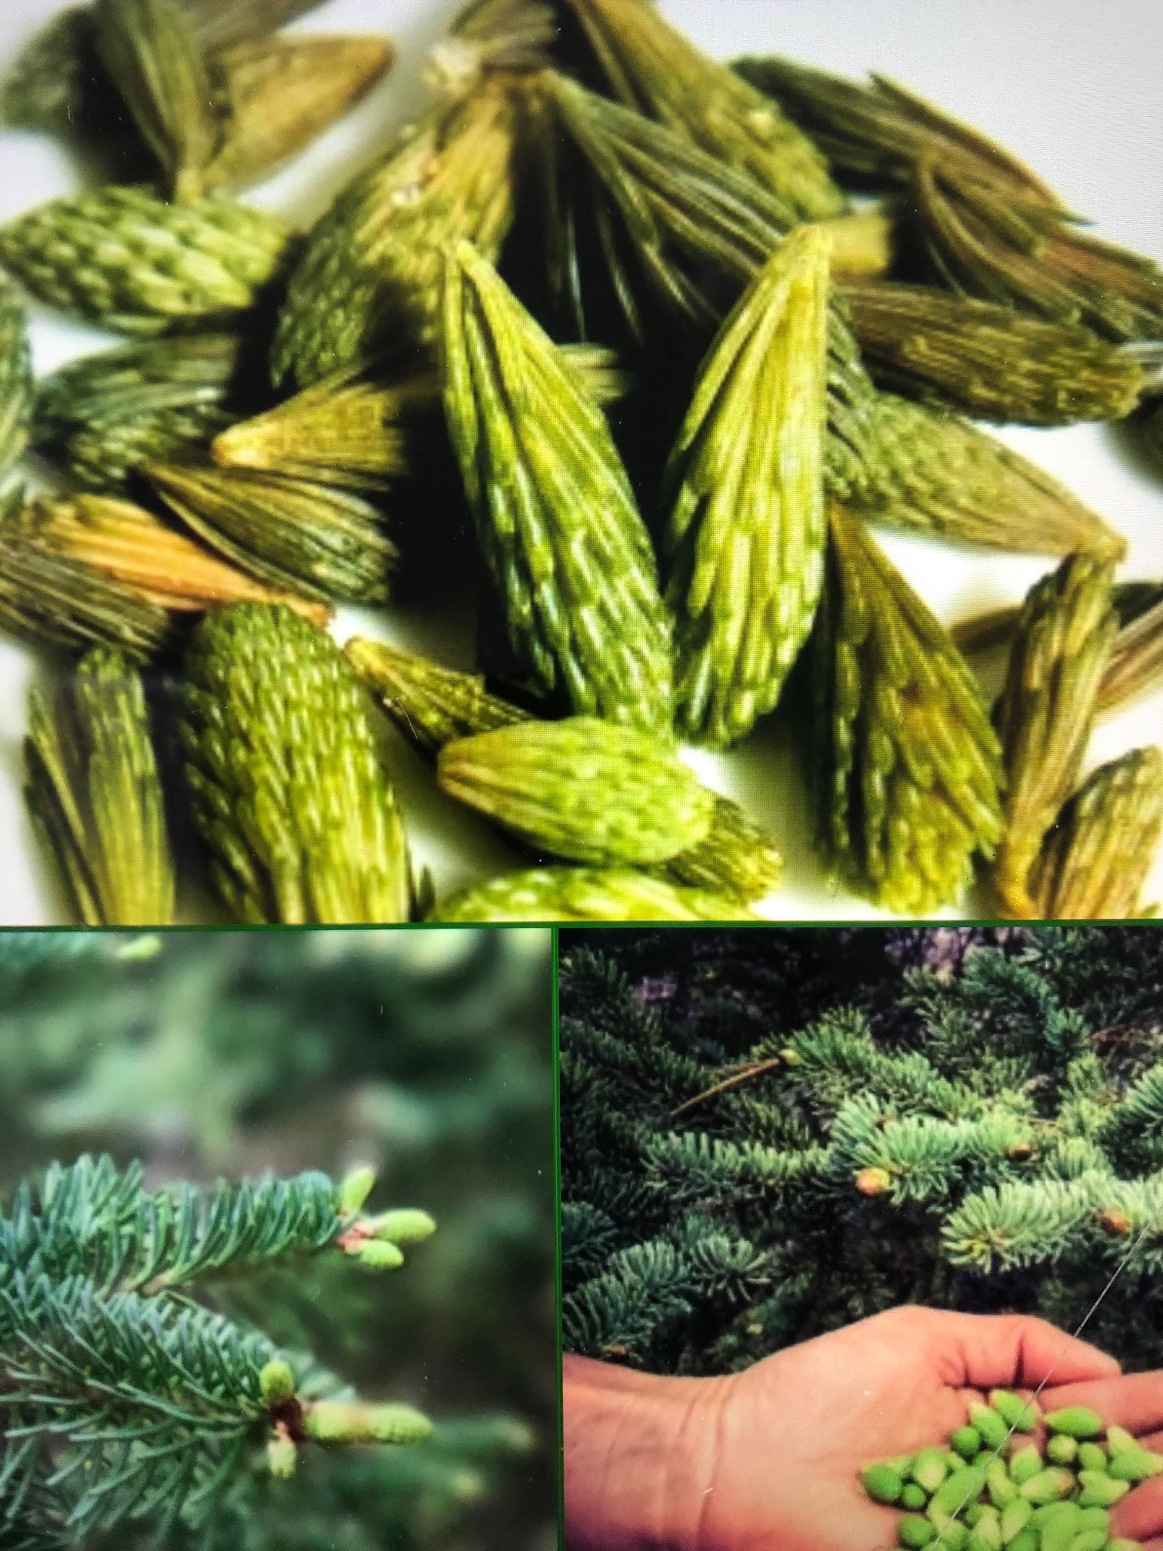
ʔəliw̓as – Spruce Tree - Spruce tips are fully of vitamins. Harvest May and June. The pitch is applied topically and is used for cuts, scrapes, lesions, eczema and skin irritations. Harvest May to July.
ʔəliw̓as

Slide 19
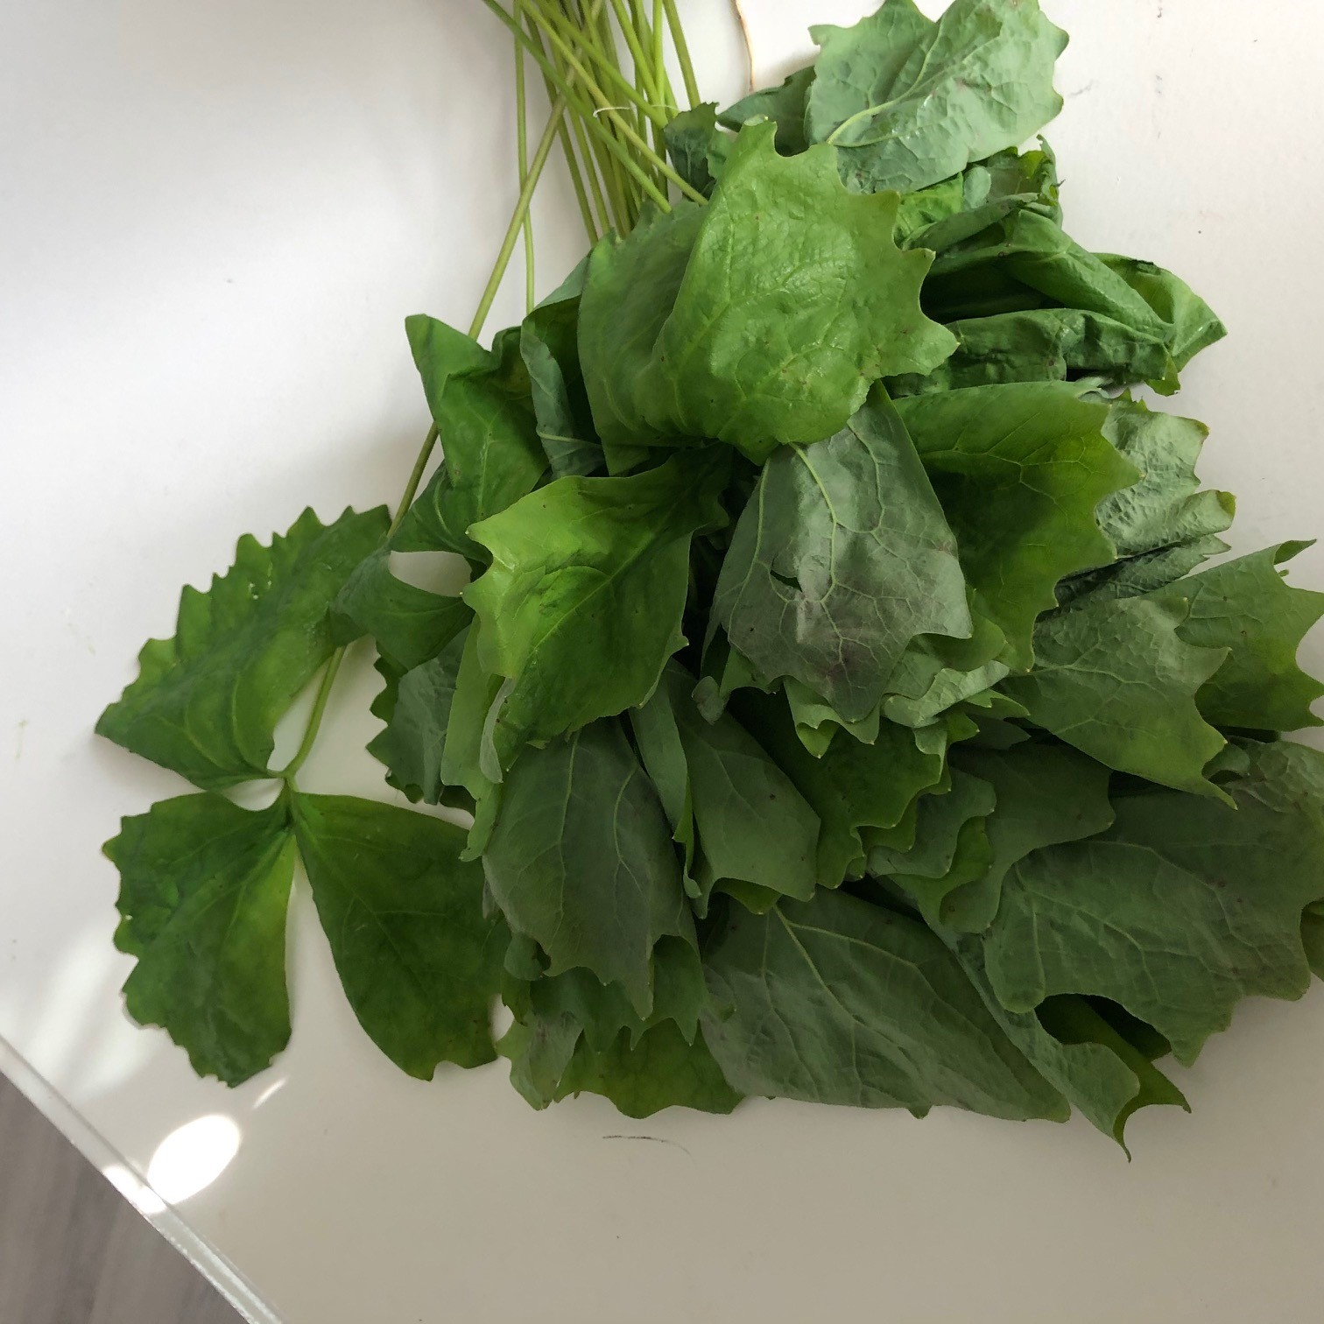
vanilla mamema can be gathered and dried. Then they can be hung in your home and they are a natural deodorizer.
vanilla mamima

